Slide 1
Transitioning to Kindergarten
What do I need to know and how do I navigate the process?

Slide 2
The Basics
Kindergarten registration has already begun!
Please register at your neighborhood school.
Sign up for the PTA Saturday workshops!
4 monthly meetings
Meet other kindergarteners in your neighborhood!
Run by parents with special guests!

Slide 3
Kindergarten Screenings
Scheduled in the spring: March/April/May
Academic screening with a kindergarten teacher (not necessarily yours)
Medical screening with the school nurse
Speech/Language screening by the Speech & Language Specialist

Slide 4
The Legal Stuff
NJ State Law (NJAC 6A:14) limits eligibility under the category “Preschool Child With A Disability” to students ages three to five.

Slide 5
The Legal Stuff (cont.)
Prior to turning 5, all students must be reevaluated to determine continued eligibility for special education and related services.
A new eligibility category must chosen.
Parents choosing not to sent their children to kindergarten must find a private preschool for their child to attend.

Slide 6
The Legal Stuff (cont.)
Most Frequently Used Eligibility Categories:
Autistic
Intellectually Disabled
Communication Impaired
Multiply Disabled
Other Health Impaired
Specific Learning Disability

Slide 7
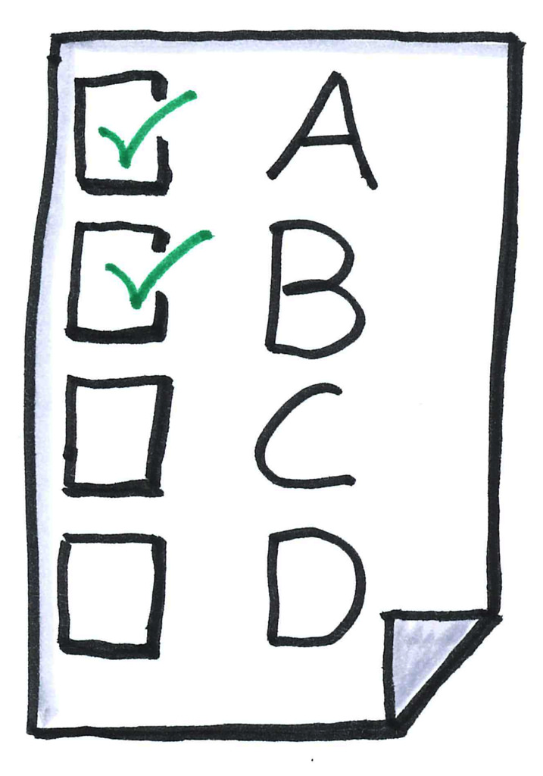
The Reevaluation Process
Reevaluation planning meeting
Standardized Assessments:
(cognitive and academic)
WPPSI-IV
Brigance IED-III
WJ ECAD

Slide 8
The Reevaluation Process (cont.)
Functional Assessments
Related Services (Speech, OT, PT)
Parent-Provided Medical Evaluations

Slide 9
When Do You Do All of This?
During the school day!
No parents necessary!
Reports sent home no less than 10 days before the eligibility meeting.

Slide 10
Eligibility Meeting?
Elise will call to arrange a mutually convenient meeting time to discuss all of the evaluation reports.
All evaluators will be present.
Eligibility for special education and related services, including eligibility category, will be determined by the Child Study Team.

Slide 11
Then What?
If it is determined that your child is eligible for special education and related services, a draft IEP will be developed at this meeting.

Slide 12
What Programs Are There For Kindergartners?
Full Day
Kindergarten
For Everyone!
(Thank you taxpayers!)

Slide 13
Resource Center Support
2-3 times/week for 30 minutes
Reading/Language Arts
Math
All four elementary schools

Slide 14
Learning and Language Disabilities (LLD)
FN Brown Elementary School
2 classes: gr. K-1 and gr. 2-4
Special education classes providing modified content and curriculum in:
Reading/Writing
Math
Science
Social Studies

Slide 15
LLD (cont.)
Mainstreaming for specials:
Art
Music
Physical Education
Library
Spanish (gr.1-4)
Peace Pals
Technology
Health

Slide 16
LLD (cont.)
Shared paraprofessionals for facilitation of small group instruction.
Supported by related services, as necessary:
Speech/Language
Occupational Therapy
Physical Therapy

Slide 17
Language Sensory and Social
(LSS)
Laning Avenue Elementary School
2 classes: currently gr. K-1 and gr. 2-4
Special Education classes providing individualized 1:1 instruction according to IEP goals and objectives.

Slide 18
LSS (cont.)
Mainstreaming will be determined on an individual basis by the student’s IEP team to maximize success.
1:1 paraprofessionals support students individually throughout the school day.
Supported by related services:
Speech/Language Therapy
Occupational Therapy
Physical Therapy

Slide 19
Related Services
All four elementary schools:
Speech/Language Therapy
Occupational Therapy
Physical Therapy
Eligibility criteria must be met.

Slide 20
Ok, so now what?
Elise will reach out for signed consent to reevaluate your child.
Once signed consent is received, evaluations will begin.
An eligibility meeting will be scheduled with you for a date no more than 60 days after your consent for evaluations is received

Slide 21
Ok, so now what?
(cont.)
Evaluation reports will be sent home via backpack no less than 10 days prior to the eligibility meeting.
If your child meets the eligibility criteria, a draft IEP will be developed at the eligibility meeting.

Slide 22
How Much Input Can I Have Into My Child’s IEP?
The Child Study Team determines whether your child continues to be eligible for special education and related services.
You are important members of the IEP team and provide input as to the program put in place.

Slide 23
Questions?

